Slide 1
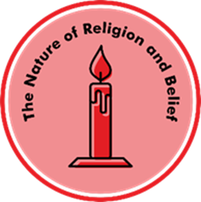
Unit CU2.1 What do Hindus believe about God?
Prior learning – Lower Key Stage Two
How do stories tell us about ourselves and the world: Ganesha goes to a party, how Mother Ganga came to India, the Blind Men and the elephant, Krishna opens his mouth, Waiting for God, The Four Friends.
Why are festivals important: Rama and Sita, Diwali
Why do Hindus care for others: Dana and Sewa
Key Learning
Brahman is God in Hindu Dharma
There are many aspects to God shows through many forms
The main 3 forms of Brahman are shown in the Trimurti
Hindus believe in reincarnation and aim to reach Moksha
Hindus generate good karma by following dharma, caring for others and by showing devotion through worship (puja)
Key Questions
What different aspects of your life do you show people?
What does the Trimurti mean?
How do different Hindus worship?
What do Hindus believe about living a good life?
How do Hindus show sewa or service?
How else do Hindus show devotion to God?
Key vocabulary
Aspects, Brahman, Paramatma, Trimurti, Murtis, Puja, Mandir, Shrine, ahimsa, dharma, karma, moksha, sewa, dana.
Transferable Question
How do different people see God?
Knowledge Organiser for Believing and Belonging © Pennine Learning Associates Ltd

