Slide 1
Dear Teacher…
Thank you for using this resource. We hope it helps you, and your pupils! This advice may help.
PowerPoints cover more than one lesson
The PowerPoint presentation matches a section in the planning provided for this unit of work. This is likely to contain material for more than one lesson. It is important not to speed through the slides without completing suggested activities or discussion. Most sections in the planning, and the matching PowerPoints, will cover two lessons. In particular, you may wish to spend one lesson looking carefully at the story and its meaning, and another with discussion, acting it out and follow up.
Please make sure you prepare and plan with staff
It is critical that delivery, style and speed reflect the needs and responses of pupils. The resource has been designed to support teachers, not to replace you! If this resource is provided as supporting material for HLTAs, cover teachers or non-specialists please ensure you prepare them carefully and plan with them.
We recommend you use the detailed planning as well as this PowerPoint
This PowerPoint is designed to be used with the detailed planning written to support the RE syllabus ‘Believing and Belonging’. We strongly recommend that you use the PowerPoint in conjunction with the planning. Please ask us how to access this if you do not have it.
To feed back and for further support and to access webinar training please email enquiries@penninelearning.com.

Slide 2
Notes for teachers
Where this lesson fits: This Pathway 4 lesson teaches the pupils how people who follow the Hindu faith pray at home and in the Mandir. It aims to develop an understanding of the importance of prayer to those who belong to the Hindu community.
Resources needed: paper
Enrichment ideas: The pupils could create a Hindu shrine in the classroom with a puja tray.
Lived experience: Interview a person from the Hindu community about what prayer means to them.
Further lesson notes and additional ideas may be found in the notes section of some slides (normal or presenter view). Please refer to the full unit plan for more activities and resources.

Slide 3
Notes for teachers
Slide 18: BBC Two - Pathways of Belief, Series, One God Many Aspects, Puja - a form of Hindu worship

Slide 4
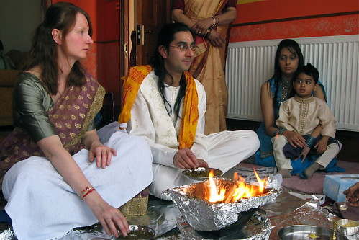
How do Hindus pray at home and at the mandir?
Unit: C1.4
How and why do people pray?
Presentation 6

Slide 5
Pathway 4: Personal Journey
Key Stage 1
Through exploring what is meant by a Personal Journey, pupils will learn that:
Some people have amazing, puzzling or mysterious experiences that make them ask big questions about life.
There are many stories about people’s experiences and encounters that have made them change their lives.
How this presentation links to the pathway:
Today you will learn about Hindu Puja at home and the Mandir and how this changes and helps Hindus live their daily lives.

Slide 6
Learning objectives
Talk about the objects on a puja tray
Talk about how the five senses are used in Hindu worship

Slide 7
Key Words
Hindu
someone who follows the teachings of Hindu Dharma
shrine
sacred or holy place where people can go to reflect or pray
puja
Hindu worship

Slide 8
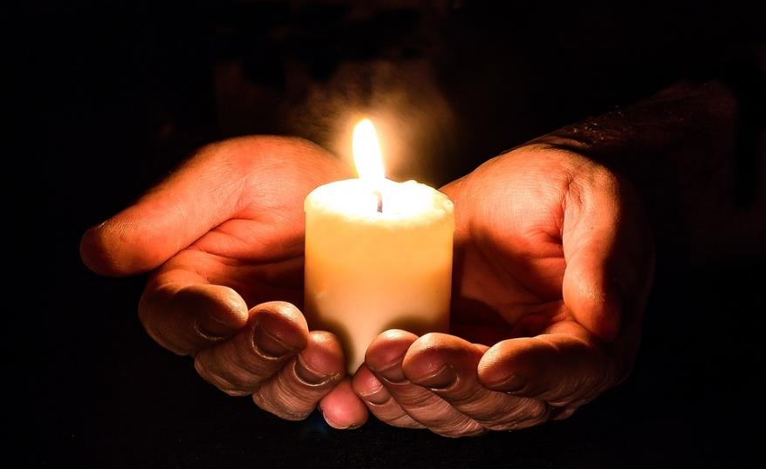
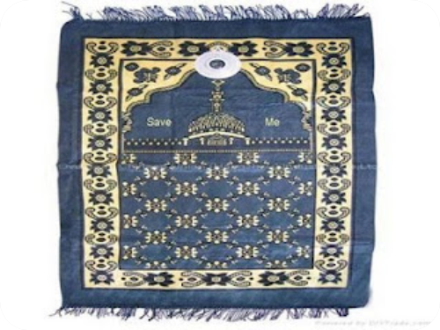
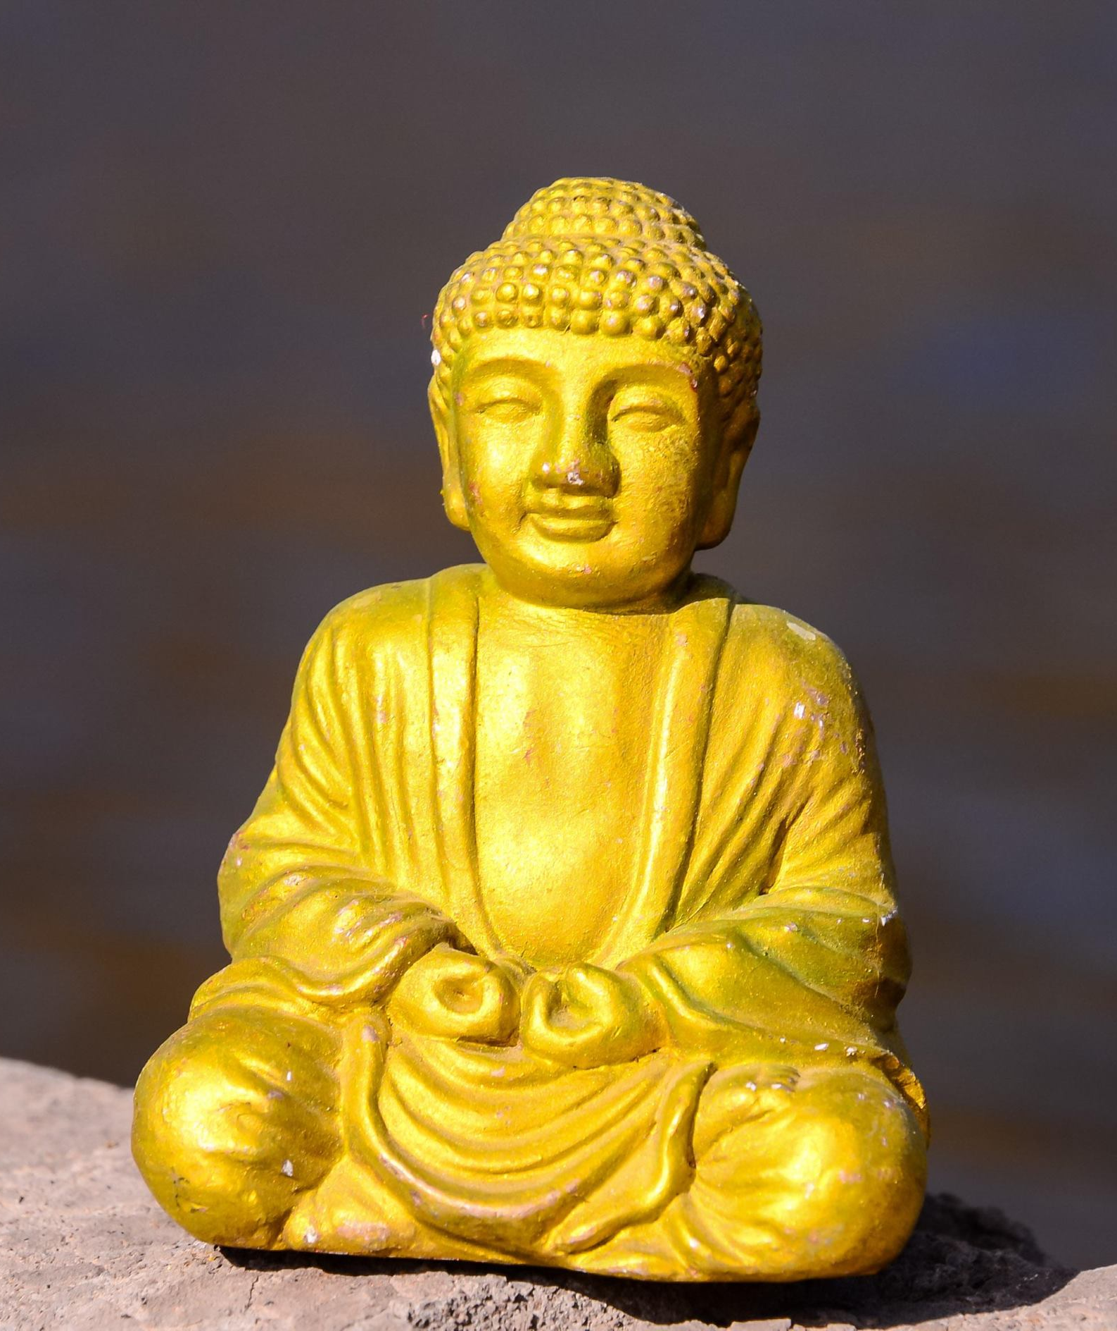
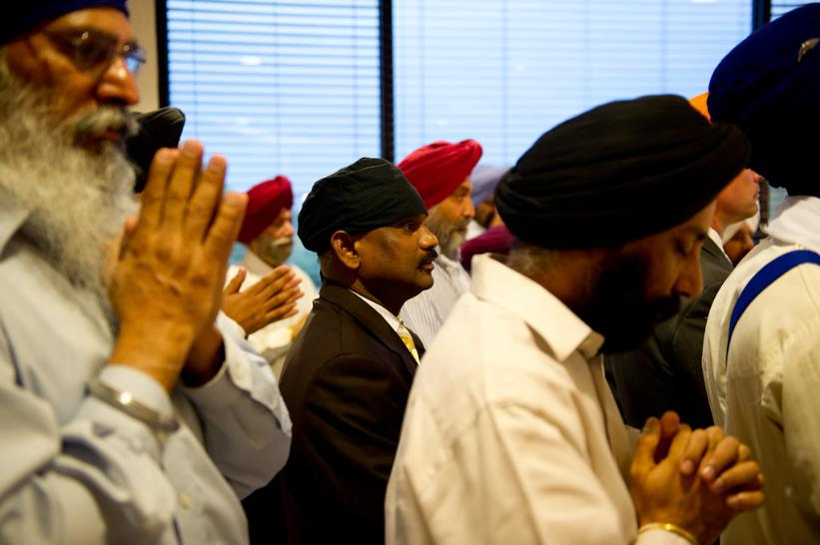
What do we already know about how and why people pray?
Say something about each of these pictures.
Can you match them with the correct faith?
Notes:
Edit the slide to suit the religions studied during the unit.

Slide 9
Introduction
Can you think of a place at home that is special to you and your family?
Why is it special?
Where would you go if you
want to be quiet or think?
How does this place help you do this?

Slide 10
How and why do Hindus pray?
Hindus recognise one God, Brahman.
They believe that there are different parts to Brahman.
Hindu gods and goddesses are called
deities. The deities show different ways to understand Brahman.
Notes:
.

Slide 11
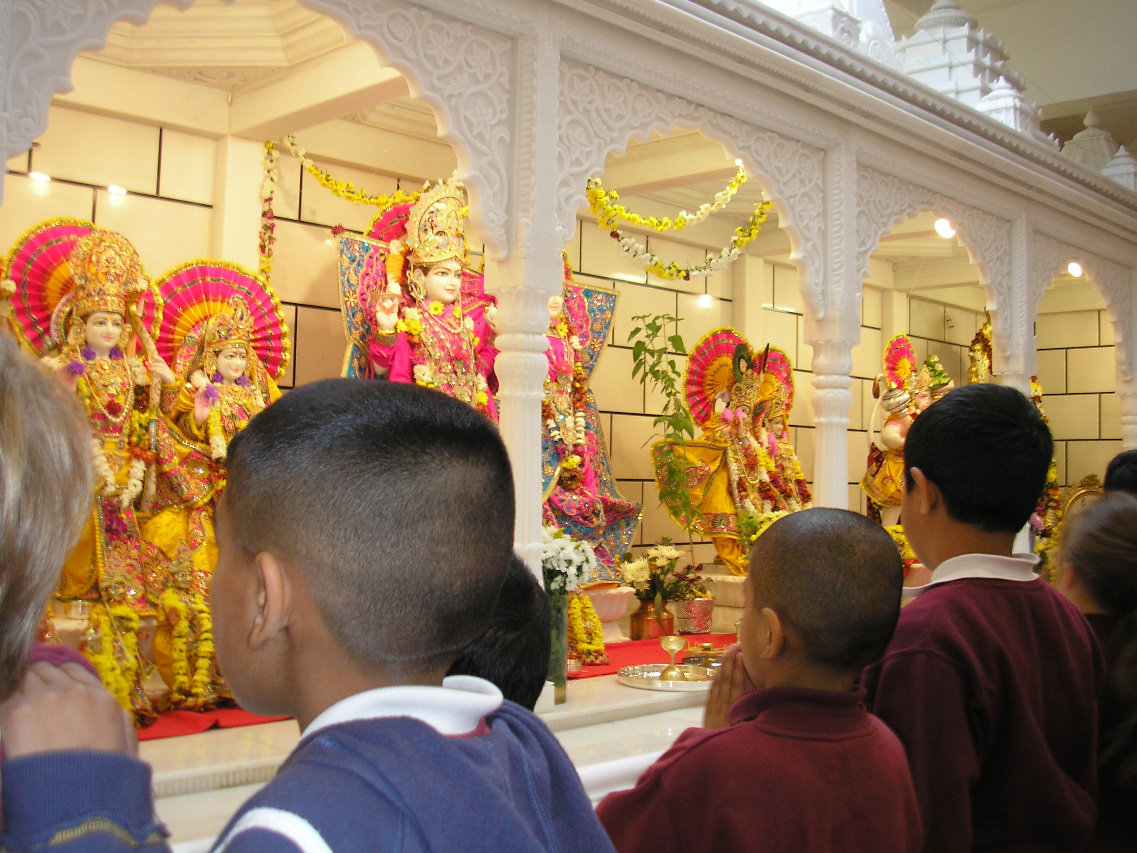
How and why do Hindus pray?
A Hindu place of worship is called a mandir. Hindus can go here at any time to be peaceful, pray and sing religious songs together.
Each mandir is dedicated to a deity
and inside will be a shrine to that
deity.
Notes:
.

Slide 12
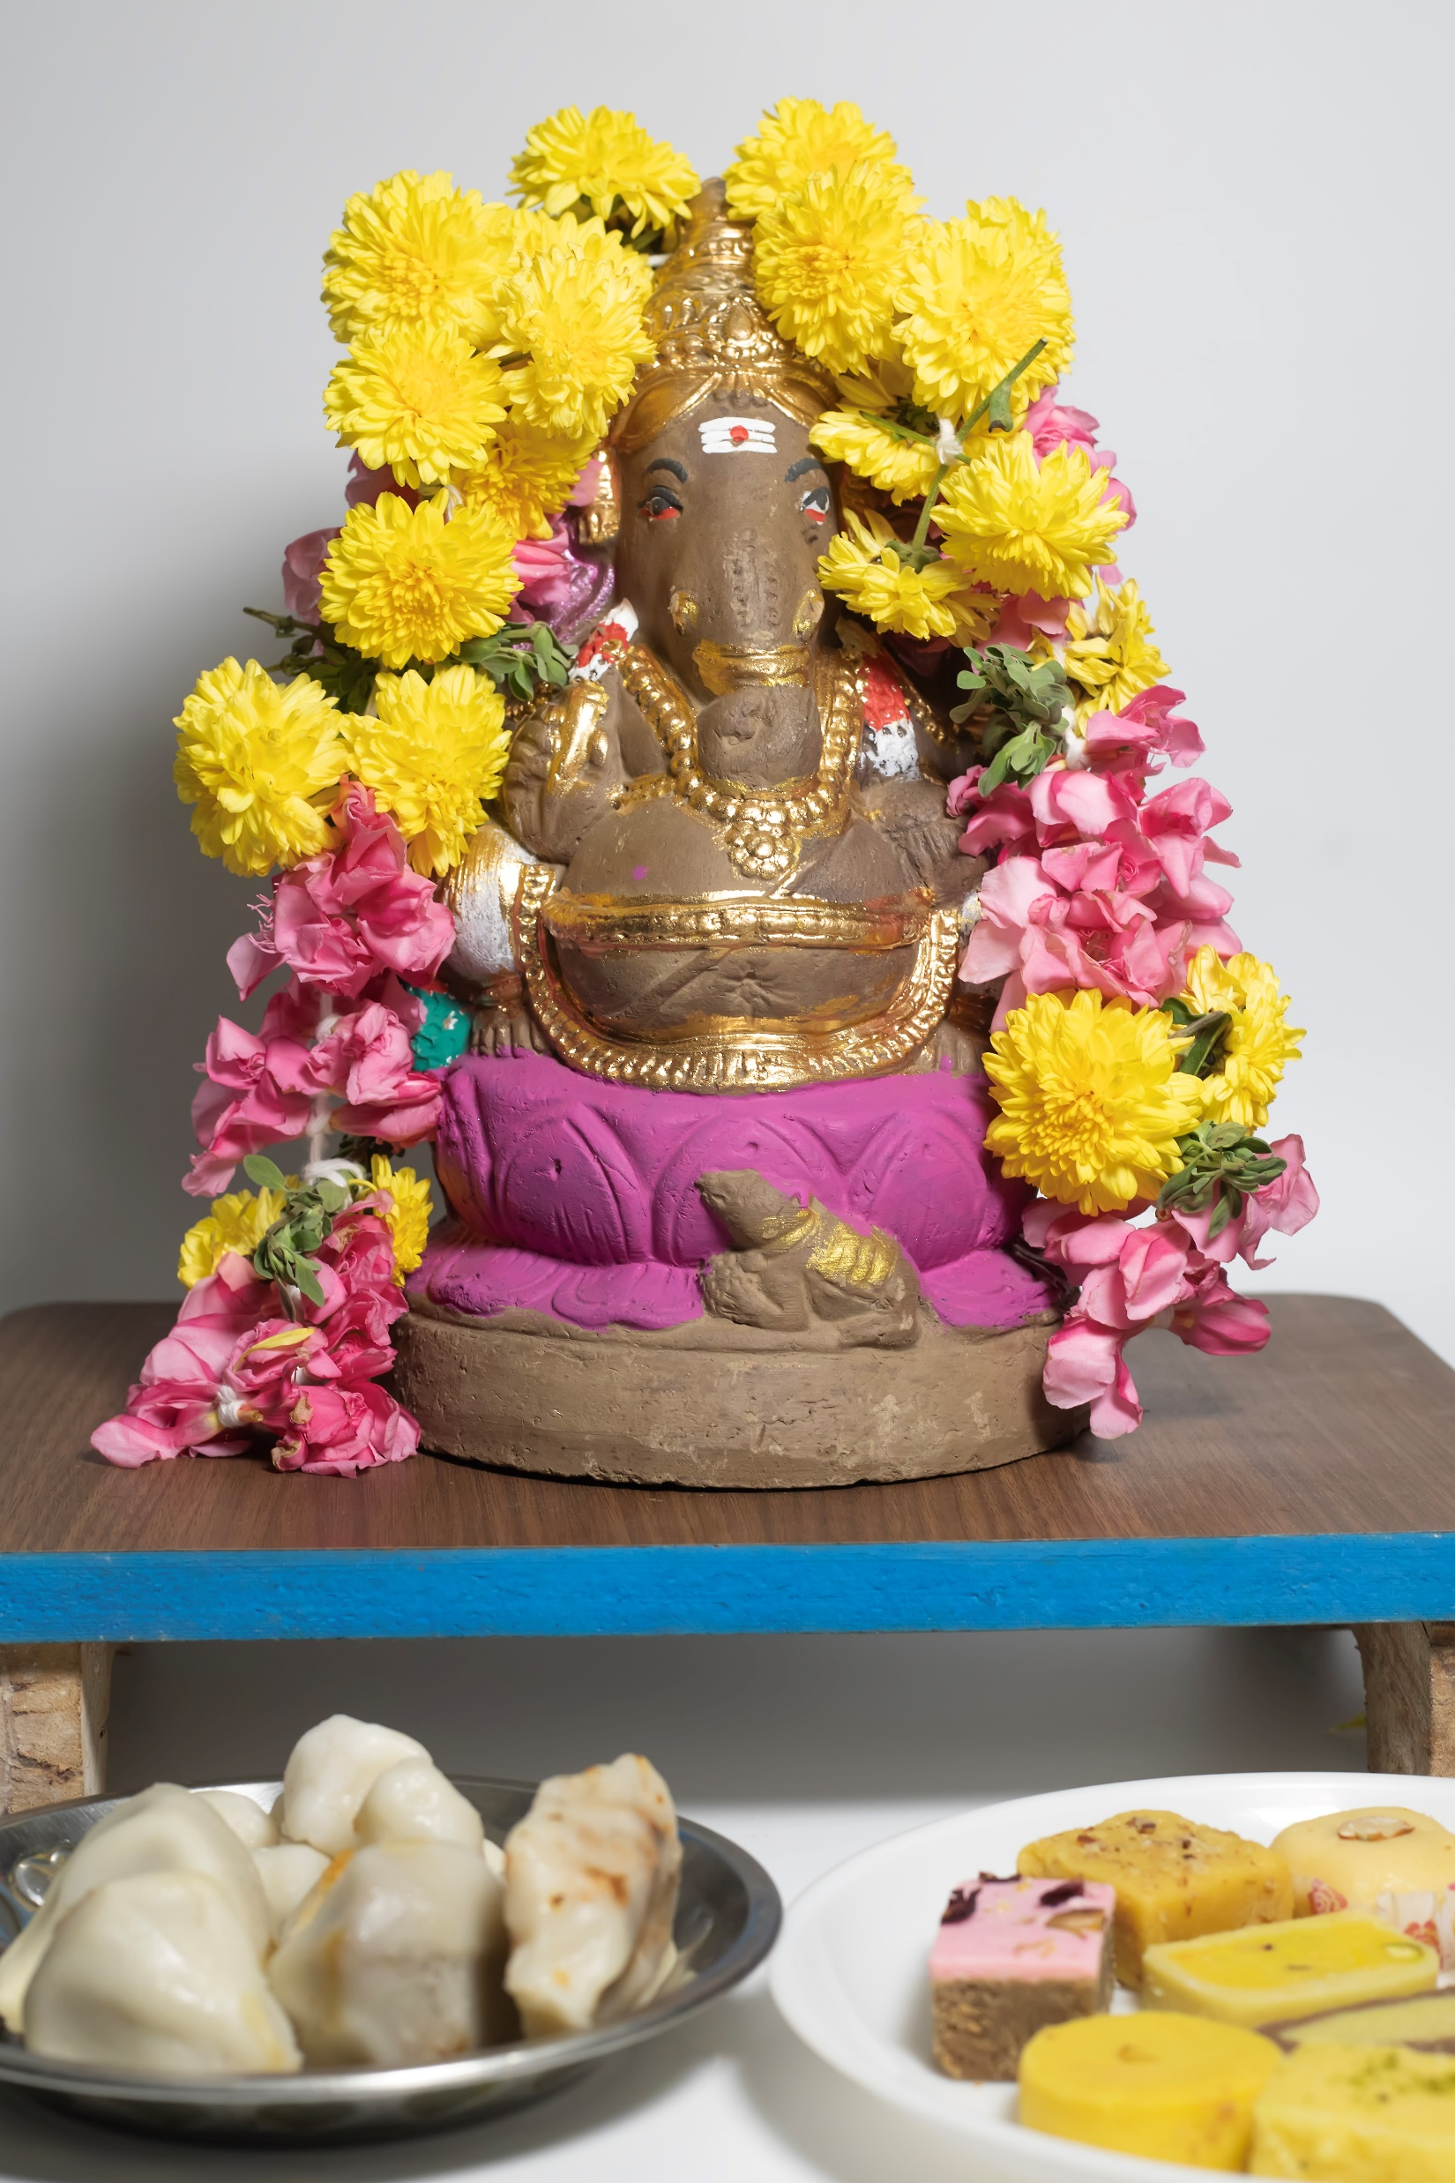
How and why do Hindus pray?
Most Hindu families have a shrine at home where they can pray to their favourite deities.
The home shrine is considered to be the most important part of the house. It is usually in the cleanest room!
Why do you think this is?
What do you notice in the shrine?
Notes:
.

Slide 13
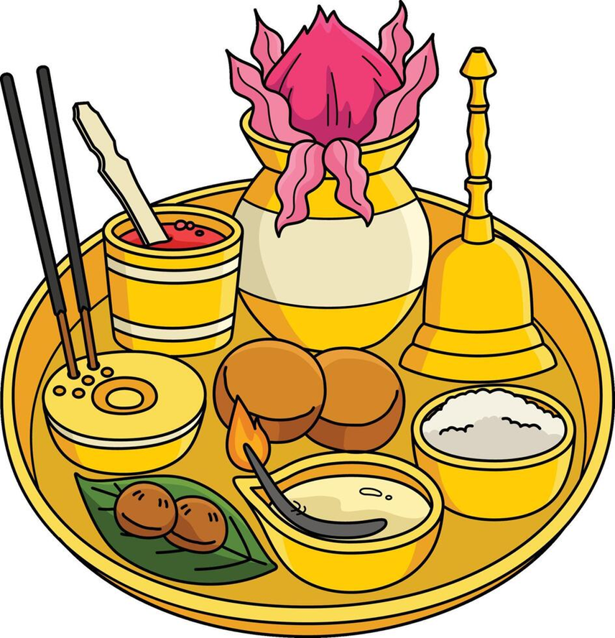
Puja
Puja involves offering light, incense, flowers and food to the the deities.
During puja Hindus chant prayers and verses from the Hindu holy books.

Slide 14
Puja tray
During puja, Hindus use many objects, which are kept on a puja tray. Puja uses all five of the senses.
What can you see?
Start to think about which of the five senses each object might use.
Notes:
.

Slide 15
Objects used in puja
flowers
kum-kum powder
bell
Incense and incense holder
diva lamp
food
Notes:
.

Slide 16
Objects used in puja
During puja, Hindus will ring the bell to let God know that they have come to pray and to invite him into the home.
Hindus will light the diva lamp and move it around in circles to bring light into the shrine. This light is a symbol of God’s presence.

Slide 17
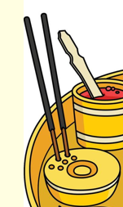
Objects used in puja
Hindus will light an incense stick and move it around the shrine in circles. This cleans the air and brings a lovely smell to the shrine.
They will make a paste out of the red kum-kum powder. They use this to make a mark on the forehead of the images of the deities.

Slide 18
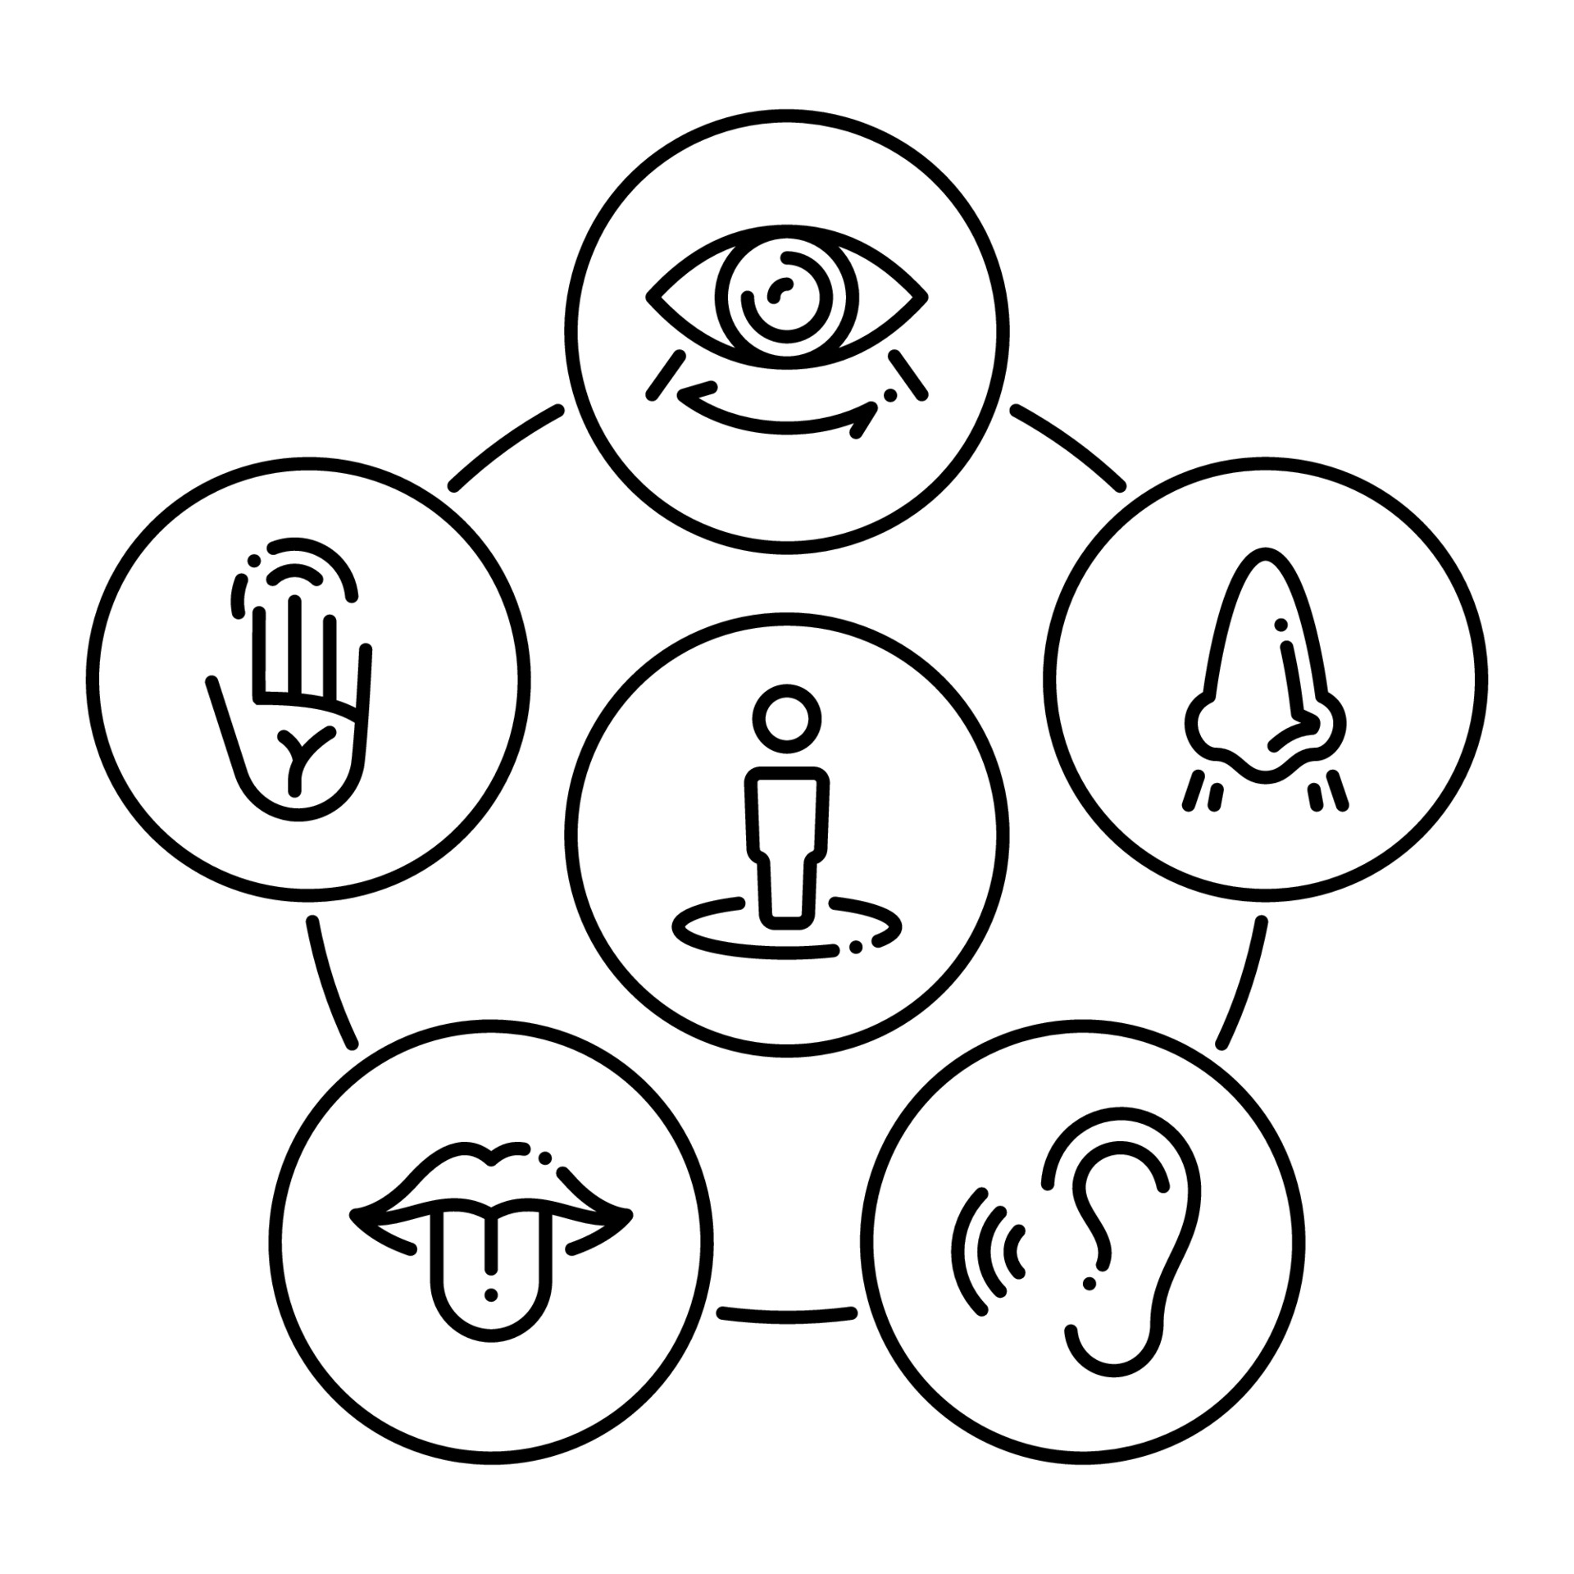
Hindu prayer in the home
Watch a film clip about Hindu prayer.
As you look and listen carefully,
think about how the five senses are used in Hindu prayer in the home?
Notes:
BBC Two - Pathways of Belief, Series, One God Many Aspects, Puja - a form of Hindu worship

Slide 19
Task: Using the five senses
How are the five senses used in Hindu prayer in the home?
What can you see?
What can you hear?
What could you smell?
What could you touch?
What could you taste?
Notes:
The children could share these in pairs or each group could focus on one sense and feedback to the class.

Slide 20
Task: Using the five senses
How are the five senses used in Hindu prayer in the home?
What could you see?
The objects in the shrine.
What could you hear?
The sound of the bell.
Notes:
The children could share these in pairs or each group could focus on one sense and feedback to the class.

Slide 21
Task: Using the five senses
How are the five senses used in Hindu prayer in the home?
What could you smell?
Smelling the incense.
What could you touch?
Touching the objects in the shrine.
Notes:
The children could share these in pairs or each group could focus on one sense and feedback to the class.

Slide 22
Task: Using the five senses
How are the five senses used in Hindu prayer in the home?
What could you taste?
Tasting the food.
Notes:
The children could share these in pairs or each group could focus on one sense and feedback to the class.

Slide 23
Task: Label a puja tray
Draw and label items that can be found on a puja tray. Think about the objects that you saw on the film clip too.
Use the words below to help you. Talk about the senses each object uses.
bell food flowers incense
Diva lamp water Kum-kum powder

Slide 24
Learning summary
Hindus believe that God is everywhere so to pray him you do not have to be in a special place
Hindu prayer is called puja. They perform this at least once a day either at home in the shrine or in the mandir
People pray for many different reasons and there are many different kinds of prayer.
During puja, Hindus use many objects, which are kept on a puja tray. Daily puja uses all five of the senses

Slide 25
What have we learned today? Brain Dump
Write down all the things that you can remember about the objects on the puja tray.

Slide 26
Time to think
What objects help you to think, reflect or pray at home?

Slide 27
Acknowledgments
All pictures used under licence from Vecteezy except:
Slide7: Sikh photo and prayer mat by Unknown Authors licensed under CC BY
Slide 10: Alastair Ross

