Slide 1
Dear Teacher…
Thank you for using this resource. We hope it helps you, and your pupils! This advice may help.
PowerPoints cover more than one lesson
The PowerPoint presentation matches a section in the planning provided for this unit of work. This is likely to contain material for more than one lesson. It is important not to speed through the slides without completing suggested activities or discussion. Most sections in the planning, and the matching PowerPoints, will cover two lessons.
Please make sure you prepare and plan with staff
It is critical that delivery, style and speed to reflect the needs and responses of pupils. The resource has been designed to support teachers, not to replace you! If this resource is provided as supporting material for HLTAs, cover teachers or non-specialists please ensure you prepare them carefully and plan with them.
We recommend you use the detailed planning as well as this PowerPoint
This PowerPoint is designed to be used with the detailed planning written to support the RE syllabus ‘Believing and Belonging’. We strongly recommend that you use the PowerPoint in conjunction with the planning. Please ask us how to access this if you do not have it.
To feed back and for further support and to access webinar training please email enquiries@penninelearning.com.

Slide 2
Notes for teachers
Where this lesson fits: This is the fourth session in the unit exploring the concept of ‘Special Places’. Having shared their own experiences of special places and looking at special places in the community, we begin to focus on places of worship. After experiencing the church as a special place for Christians, we focus on the mosque as the place of worship for Muslims. Again, we focus on the awe and wonder inspired by visiting the mosque.
​
Points to note: Be aware when handling some religious artefacts that there are some restrictions on the way some objects are used and handled e.g. the Qur’an is stored covered on a high shelf. Supervise children when handling holy books and give them children's versions to handle independently.
​
Religious Education in Early Years settings: Activities may be adapted to suit Reception and Nursery settings. See the full unit plan for links to Early Learning Goals and a full range of ideas for adult-led and independent activities.​
​
Further lesson notes and additional ideas may be found in the notes section of some slides (normal or presenter view).​
​
Enrichment ideas: Ideally, this session would take place in a mosque or involve inviting an Imam or Muslim to talk about their mosque, showing some of things related to the mosque like prayer mats or prayer beads.
​
Outdoor learning: Build a special place/place of worship using blocks and crates in the outdoor area.
​
Resources needed: Photographs of different mosques, Islamic artefact box, persona doll (optional).

Slide 3
Notes for teachers
Slide 10: 6 different virtual mosque tours if you cannot visit in person: VMM_360TourGuideProfiles.pdf
Slides 15 and 16: These slides are intended for teacher reference rather than to display for the children.​
​
Slide 21: sound file for Arabic call to prayer-
Online story with the theme of special places:
https://www.youtube.com/watch?v=l5a1U0Dmmls - The best place in the world by Petr Horacek

Slide 4
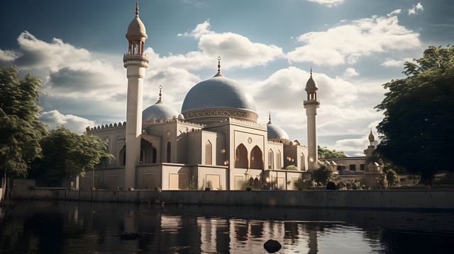
Which places are special to Muslims and why?
Unit: E.1
Which places are special to members of our community?
Presentation 4

Slide 5
Pathway 1: The Nature of Religion and Belief
Early Years
Through investigating the Nature of Religion and Belief, pupils should learn that:
We are surrounded by important objects and places that are special to members of the community.
Some special objects and places are called ‘precious’, 'sacred' or 'holy'.
How this presentation links to the pathway:
Today we are learning about special or holy places for Muslims called mosques.

Slide 6
Learning objectives
Name the mosque as a special place for Muslims
Talk about why mosques are special places for Muslims

Slide 7
Key Words
Muslim
A person who follows the religion of Islam
Mosque
A special building where Muslims worship Allah
The Arabic word for God
Allah

Slide 8
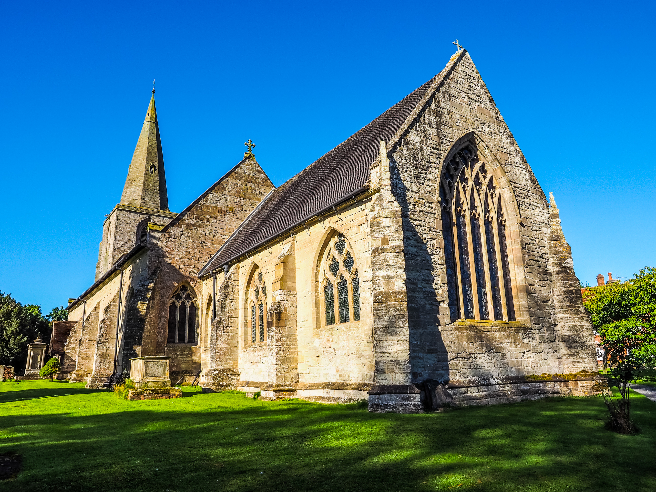
Recap: Places of worship
What is this place called?
Who is it special for?
What gave you a clue?
How is it a special place?
Notes:
Can the children name a church as a special building for Christians? Encourage them to describe what is special about a church, thinking about the inside / outside and why it is special to Christians. You may want to return to the slides from session 3 to look back at interior views/ photographs of different churches. If you visited a church, use the photographs / videos taken and enourage children to describe how they felt during the visit. Some answers are on the next slide, the children will likely identify more.

Slide 9
Recap: Places of worship
A church
Christians
Stained glass,
spire
Worship,
special things
Notes:
Ideally, you would visit a local mosques as an introduction, focusing on the awe and wonder they inspire as you enter and walk around. Alternatively, you could explore a virtual tour such as one of six mosques on VMM_360TourGuideProfiles.pdf (there are many virtual tours online so you could search for one local to you).

Slide 10
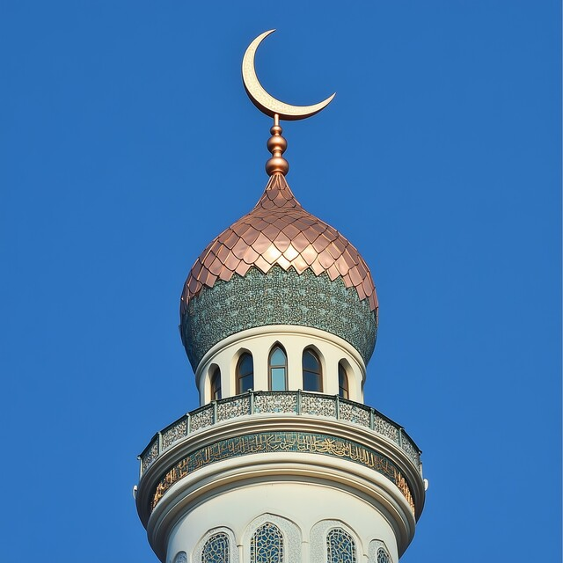
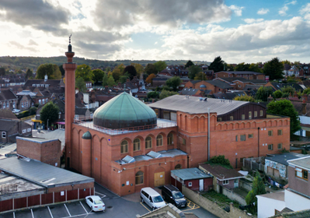
Introduction: Visiting a mosque
A mosque is a special place for Muslims. What do you wonder about it?
Notes:
Ideally, you would visit a local mosques as an introduction, focusing on the awe and wonder they inspire as you enter and walk around. Alternatively, you could explore a virtual tour such as one of six mosques on VMM_360TourGuideProfiles.pdf (there are many virtual tours online so you could search for one local to you).

Slide 11
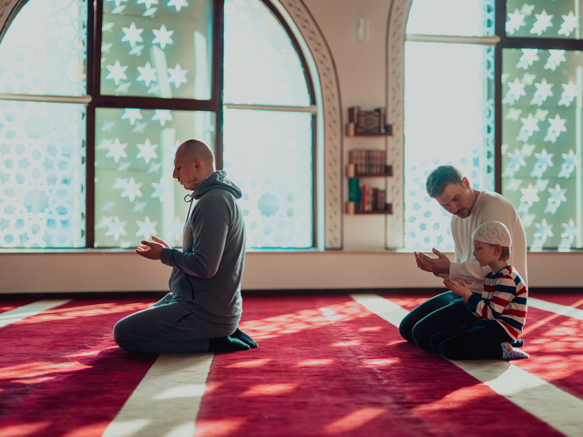
Introduction: At the mosque
My name is Zayn and I am a Muslim. I follow the religion of Islam. Here I am in my special place, my mosque. Before I go inside, I have a wash so that I feel clean ready to worship Allah. When I kneel on the soft carpet, I feel calm and safe.
Notes:
Ideally, you would visit a local mosques as an introduction, focusing on the awe and wonder they inspire as you enter and walk around. Alternatively, you could explore a virtual tour such as one of six mosques on VMM_360TourGuideProfiles.pdf (there are many virtual tours online so you could search for one local to you).

Slide 12
Introduction: At the mosque
In the mosque, there are patterns on the walls all around me. They make me think of only Allah. I see my friends and family at the mosque and we worship together, all facing the same way.
Notes:
Ideally, you would visit a local mosques as an introduction, focusing on the awe and wonder they inspire as you enter and walk around. Alternatively, you could explore a virtual tour such as one of six mosques on VMM_360TourGuideProfiles.pdf (there are many virtual tours online so you could search for one local to you).

Slide 13
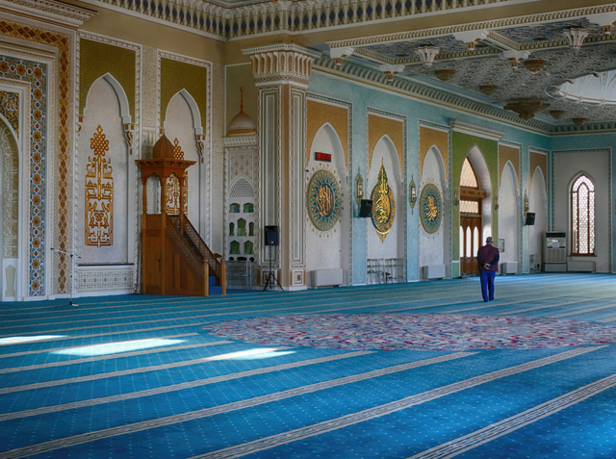
Introduction- Inside a mosque
Look at the inside of this mosque.
What special objects or pictures can you see?
Notes:
Ask the children to talk about why they think some children like to go to church and what might make it a special place for them.

Slide 14
Introduction: Inside a mosque
What would you like to know about this special place?
What question would you ask?
Notes:
Ask the children to talk about why they think some children like to go to church and what might make it a special place for them.

Slide 15
Place of worship script
Look around carefully. This is a special place, and we are going to be very quiet and careful.
Look for some beautiful and interesting objects. You might draw a picture, take a photo or remember it some other way. Look for beautiful and interesting colours, pictures or patterns. You might want to draw them, or remember them.
You might want to tell a grown up about the lovely things you have found.
Notes:
Ideally, you would visit a local mosque as an introduction, focusing on the awe and wonder they inspire as you enter and walk around. Alternatively, you could explore a virtual tour such as those on Visit My Mosque Virtual Tours UK - 360 Virtual Tour Co. (there are many virtual tours online so you could search for one local to you).

Slide 16
Ideas for adult-led tasks
During the mosque visit, decide what they think is ’special’ and take photos. Talk about their choice. Create a guidebook about the visit, including pictures and photos.
Create a memory box about their special visit. Use the photos and objects brought back from the visit. Talk with the children about how we care for our precious things.
If you have a visitor, follow up by looking together at some Islamic artefacts from the school resource box. Handle them carefully (see teacher notes) and talk about why they are special or precious.
Notes:
Select an adult- led task. If you are visiting a mosque, the first activity provides follow- up.

Slide 17
Ideas for independent tasks
Add to the memory box about their special visit. Draw pictures, write words and create objects to put in the box. Adults could record quotes.
Make a prayer mat using paper or textiles. Use patterns rather than images to decorate it to reflect the fact that Islamic art does not include images of people or animals.
Give the children a selection of photographs of different mosques, including local ones that may look like homes or civic buildings on the outside. Discuss with the children and notice similarities and differences. Sorting hoops could be used with children who are confident to group pictures together. Encourage children to explain their sorting.
Build a special place/place of worship using blocks and crates in the outdoor area.
Notes:
Select at least one independent task for provision.

Slide 18
Learning summary
A mosque is a special place for Muslims
Muslims feel close to Allah when they are in the mosque. They often worship together, saying thanks to Allah.
Sikhs follow the teachings of Guru Nanak
Mosques have special objects which are looked after carefully. They often have beautiful patterns on the walls.

Slide 19
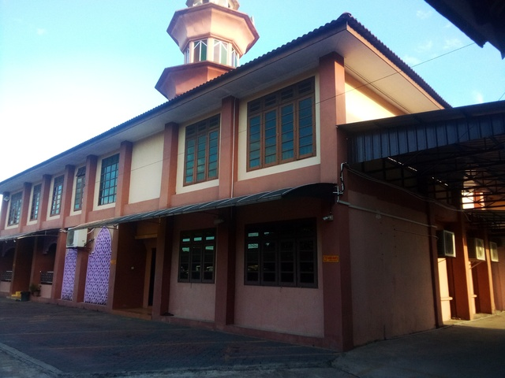
What have we learned today?
How are these mosques the same? How are they different?
Notes:
Encourage the children to notice similarities and differences between the mosques. You could add pictures of the mosque you have visited here.

Slide 20
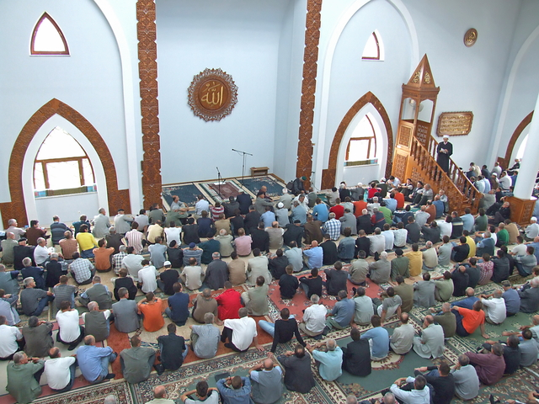
What have we learned today?
How are these mosques the same? How are they different?
Notes:
Repeat the activity looking at interior views and discussing special objects. Again, you could use photographs from the mosque you have visited.

Slide 21
Time to think
Listen to the Arabic call to prayer.
Move around the room and stop when the call to prayer stops.
How did it make you feel?
Notes:
Listen to the call to prayer in Arabic. What might it mean? Explain that it means “Come to God. Come to Prayer. There is only one God”. This tells Muslims it is time to pray. Link to church bells calling people to church.

Slide 22
Acknowledgments
All photos from Vecteezy.

