Slide 1
Dear Teacher…
Thank you for using this resource. We hope it helps you, and your students! This advice may help.
PowerPoints cover more than one lesson
The PowerPoint presentation matches a section in the planning provided for this unit of work. This is likely to contain material for more than one lesson. It is important not to speed through the slides without completing suggested activities or discussion. Most sections in the planning, and the matching PowerPoints, will cover two lessons.
Please make sure you prepare and plan with staff
It is critical that delivery, style and speed reflect the needs and responses of students. The resource has been designed to support teachers, not to replace you! If this resource is provided as supporting material for cover teachers or non-specialists, please ensure you prepare them carefully and plan with them.
We recommend you use the detailed planning as well as this PowerPoint
This PowerPoint is designed to be used with the detailed planning written to support the RE syllabus ‘Believing and Belonging’. We strongly recommend that you use the PowerPoint in conjunction with the planning. Please ask us how to access this if you do not have it.
To feed back and for further support and to access webinar training please email enquiries@penninelearning.com.

Slide 2
Notes for teachers
This is lesson 2 in the unit. The unit aims to introduce students to the wide variety of worship enjoyed by Christians. It allows students to explore the concept of worship itself and come to an understanding of why it is important to Christians, whatever form it may take. The main elements under study are liturgical and non-liturgical worship, prayer, the festival of Christmas and/or Easter, and the potential influence of worship on believers. An optional element on the phenomenon of pilgrimage is also offered. Students will be able to evaluate the possible advantages of different types of worship for themselves, once they have an understanding of the form and nature of Christian worship.
Slide 7: Print this out A5 so that all students can fill it in
Slides 8-13: are designed to be teacher-led. The pictures and videos should bring the worship to life and help students see what attending a liturgical service might be like but be ready to answer questions or clarify confusions along the way
Slide 14: The video location is embedded – https://www.youtube.com/watch?v=OWGA1d8Q-6Y
Slide 15: You may want to print this out so that students can refer to the instructions easily and check their work against the example.
Slide 16: All students will need a blank copy of the table to fill in, using the information sheet (slide 21)
Slide 21: All students will need a copy of this to help with the table task. Opportunities for wider learning: students could consider questions they might like to ask a practicing Christian about which elements of worship they most enjoy or feel they benefit the most from.

Slide 3
What is liturgical worship?
Unit: C3.3
How do Christians worship differently?
Presentation 2

Slide 4
Pathway 2: Expressing Beliefs
Key Stage 3
Through investigating how beliefs are expressed, students should learn that:
People convey their beliefs, values, commitments and identities in a range of ways.
They can also be interpreted differently, with some regarding them as divinely inspired.
How this presentation links to the pathway:
In this text presentation you will be examining liturgical worship as a model for Christians to express their beliefs.

Slide 5
Learning objectives
To identify the key features of Christian liturgical worship
To suggest benefits of each element of worship

Slide 6
Key Words
Set Prayers
Prayers already written down and recited
Creed
A statement of faith for Christians
The sharing of bread and wine to commemorate the death of Jesus
The Eucharist

Slide 7
Introduction
Think back to last lesson. Fill in the retrieval summary below, using the words in the grid below.
Worship means to show _________ to something. In Christianity, it is the way _____________ show god he is _________________ to them. Worship can take __________ forms, but it usually has common features, including ___________ and sung ______________. Christians might pray to God for a lot of different reasons including saying __________ _______ or _________. Christians sometimes worship ____________________ and sometimes _________ at home. There is no one way to do it.
important | collectively | prayers | Christians | thank you
sorry | worth | alone | worship | many

Slide 8
Explanation: Liturgical worship
Liturgical worship is worship with a set order which is written down in a service book. It follows the same format every week, though some things will be different each time e.g. hymns and Bible readings. Many of the congregation will know lots of the service off by heart and many of them take comfort in hearing the familiar words each time. We are going to explore several important parts of liturgical worship. These are:
Prayers of Confession
The Bible Readings
Set Prayers
The Creed
The Eucharist

Slide 9
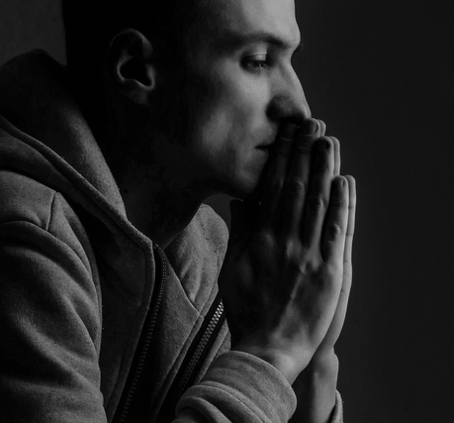
Prayers of Confession
These happen near the start of the service and are prayers asking for God’s forgiveness for all Christians have done wrong. It is only if they ask for forgiveness that they can access heaven. However, Christians believe heaven is possible for even the worst of us, as long as we are truly sorry!
By receiving forgiveness from God, Christians are then in a better position to enjoy the rest of the service. The celebrant (the person leading the service) can assure them that we are forgiven as he acts ‘in personae Christi’ (in the person of Christ) at this point.

Slide 10
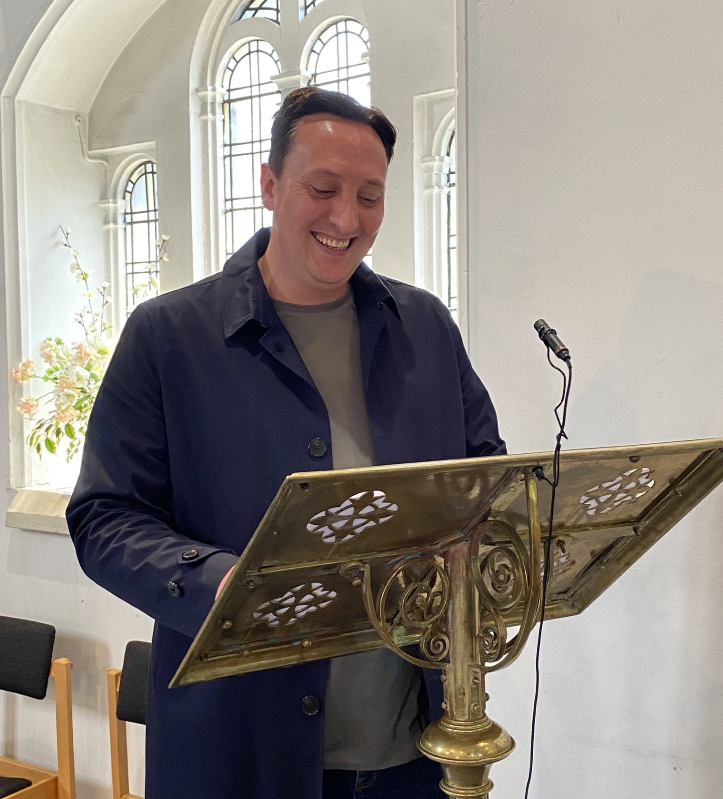
Bible Readings
These are more properly called The Liturgy of the Word and there are typically three readings each week:
Old Testament
New Testament
Gospel
The readings change each time, so that Christians learn more and more about what the Bible teaches by attending church each week. Members of the church often take turns to do the readings. Usually, they are the starting point of the Sermon (explanatory talk) given be the celebrant later in the service. This helps explain the deeper meaning of the readings and how God wants us to live.
Notes:
Be ready to explain some of these ideas – do students know the difference between old and new testaments, and what the Gospels are?

Slide 11
Prayers
The Lord’s Prayer
Our Father in heaven,
hallowed be your name,
your kingdom come,
your will be done,
on earth as in heaven.
Give us today our daily bread.
Forgive us our sins
as we forgive those who sin against us.
Lead us not into temptation
but deliver us from evil.
For the kingdom, the power,
and the glory are yours
now and for ever.
Amen.
There are lots of prayers at different points in the service. Many of these are fixed and are the same each week e.g. The Lord’s Prayer. Others are called intercessions and vary at each service. They might be led by a member of the church, and they often reflect on current affairs and worries. It is usual for particular members of the church to be named and remembered, particularly if they are struggling with illness or other difficult circumstances. In this way, Christians ask for God’s help in the well-being of the whole world.
Notes:
Be ready to explain some of these ideas – do students know the difference between old and new testaments, and what the Gospels are?

Slide 12
The Creed
I believe in God, the Father almighty,
creator of heaven and earth.
I believe in Jesus Christ, his only Son, our Lord,
who was conceived by the Holy Spirit
and born of the virgin Mary.
He suffered under Pontius Pilate,
was crucified, died, and was buried;
he descended to hell.
The third day he rose again from the dead.
He ascended to heaven
and is seated at the right hand of God the Father almighty.
From there he will come to judge the living and the dead.
I believe in the Holy Spirit,
the holy catholic church,
the communion of saints,
the forgiveness of sins,
the resurrection of the body,
and the life everlasting. Amen.
The Creed is a summary of all the key Christian beliefs. It is given here on the right. Everyone in church will stand and recite this together, usually all facing the same way, towards the altar. It reminds Christians of what they should believe so that they do not get confused in their faith or fall into false belief, known as heresy. Many Christians will know The Creed by heart as they have recited it so many times. The main beliefs summed up in The Creed are in the Father, Son and Holy Spirit, the resurrection of the dead and the eventual second coming of Jesus when Christians believe the Kingdom of God will be established on earth and all will be judged.

Slide 13
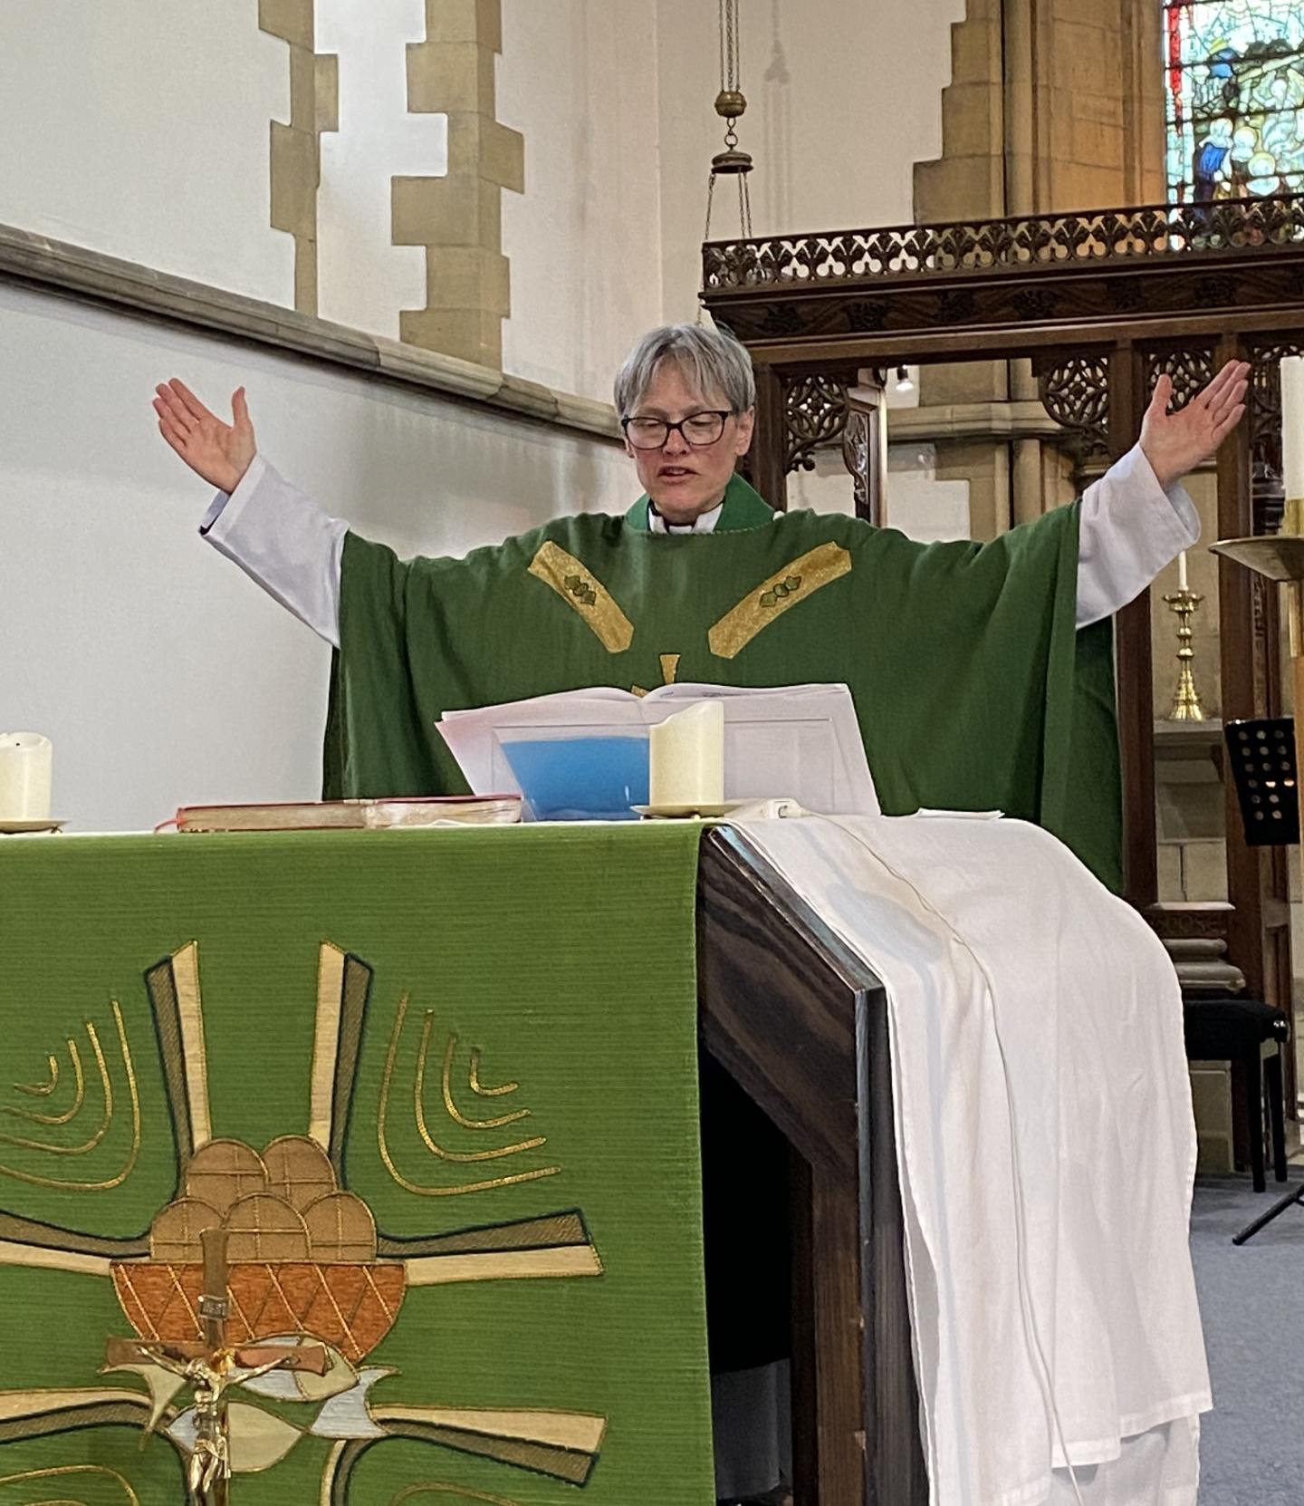
The Eucharist
The Eucharist is the sharing of bread and wine by all present. This is done because Jesus commanded his disciples to do it, ‘in remembrance of me’ and the practice has continued ever since. The exact words of Jesus at the Last Supper, before he was arrested and then crucified, are repeated by the vicar, who also has various actions to perform (see picture). The bread and wine are then distributed to everyone present. Some Christians believe in transubstantiation. This is the idea that the bread and wine are transformed into the actual body and blood of Jesus. Other Christians see the bread and wine as symbols of Jesus’ sacrifice. Either way, for many, this is the high point of the service.

Slide 14
Here is a short video showing how, typically, the Eucharist is given out in a Christian service.
Notes:
https://www.youtube.com/watch?v=OWGA1d8Q-6Y
You can either follow the address here or click on the image so a short video on handing out the Eucharist.

Slide 15
Task
Using the information sheet provided, and by reflecting on what you have seen in the previous slides, fill in the table provided. See right for an example of a filled column.
Label each column, being careful with tricky spellings
Explain what happens in each element of liturgical worship
Explain what the benefit is of the element

Slide 16
Elements of Liturgical Worship

Slide 17
Learning summary
Liturgical worship has a set order which is similar at each service
Main elements of liturgical worship include confession, the creed and set prayers

Slide 18
Wrap up
This lesson has covered key elements of liturgical worship
Answer the following questions:
What is meant by liturgical worship?
What happens in the prayer of confession?
Describe the pattern of readings from the Bible
What different types of prayer are included in the service?
What is a Creed? What does it aim to guard against?
What is the Eucharist? Can you remember the two different opinions on what is happening at this point in the service?
Notes:
Target individuals or use a randomiser. Where a student can’t answer, ‘bounce’ the question on and then get the first student to repeat the answer to reinforce learning.

Slide 19
Do you think doing things the same each time is enjoyable, or does it get boring?
How might this apply to prayer or reflection?

Slide 20
Acknowledgments
Images on slide 4 and 9 Vecteezy
Slide 10, 13 and 14: special thanks to the Reverend Catherine Shelley, vicar of St Mary’s Church, Todmorden, and the congregation there.

Slide 21
Elements of Liturgical Worship
There are lots of prayers at different points in the service. Many of these are set prayers are the same each week e.g. The Lord’s Prayer but some are called intercessions, and these are different each week. They might be led by a member of the church, and they often reflect on current affairs and worries. It is usual for particular members of the church to be named and remembered, particularly if they are struggling with illness or other difficult circumstances. In this way, Christians ask for God’s help in the wellbeing of the whole world.
Prayers of Confession happen near the start of the service and are prayers asking for God’s forgiveness for all we have done wrong. It is only if we ask for forgiveness that we can access heaven. However, Christians believe heaven is possible for even the worst of us, as long as we are truly sorry!
By receiving forgiveness from God, we are then in a better position to enjoy the rest of the service. The celebrant (the person leading the service) can assure us that we are forgiven as he acts ‘in personae Christi’ (in the person of Christ) at this point.
The Eucharist is the sharing of bread and wine by all present. This is done because Jesus commanded his disciples to do it, ‘in remembrance of me’ and the practice has continued ever since. The exact words of Jesus at the Last Supper, before he was arrested and then crucified, are repeated before the bread and wine is distributed to everyone present. Some Christians believe in Transubstantiation. This is the idea that the bread and wine miraculously change into the actual body and blood of Jesus. Other Christians see the bread and wine as symbols of Jesus’ sacrifice. Either way, for many, this is the high point of the service.
The Creed is a summary of all the key Christian Beliefs. Everyone in church will stand and recite this together, usually all facing the same way, towards the altar. It reminds Christians of what they should believe so that they do not get confused in their faith or fall into false belief, known as heresy. Many Christians will know The Creed by heart as they have recited it so many times. The main beliefs summed up in The Creed are in the Father, Son and Holy Spirit, the resurrection of the dead and the eventual second coming of Jesus when Christians believe the Kingdom of God will be established on earth and all will be judged.
The Bible readings, also called The Liturgy of the Word, usually comprise three readings each week:
Old Testament
New Testament
Gospel
The readings change each time, so that Christians learn more and more about what the Bible teaches by attending church each week. Members of the church often take turns to do the readings. Usually, they are the starting point of the Sermon (explanatory talk) given be the celebrant later in the service. This helps explain the deeper meaning of the readings and how God wants us to live.

